Slide 1

An overview of Database Management
Chapter 1

Slide 2
Today, Organizations Need...
Information to compete effectively
Information just to stay alive in the information age
Information organized in such a way that you can easily and quickly get to it
Information-processing tools that help you work with information

Slide 3
Applications of Database Systems
Supermarket:
bar code reader, price of the item, products database
Credit Card:
the purchases, credit limit, list of stolen or lost cards
Travel Agent:
holiday, flight and hotel details
University Library:
books, users and reservations

Slide 4
What you will learn
1 What is a database system ?
2 Why are database systems desirable?
3 Simple Operations on database
4 Components of the Database System
Types of data models
and the differences between them
Data Independence
7 Others

Slide 5
1 What is Database system?

Slide 6
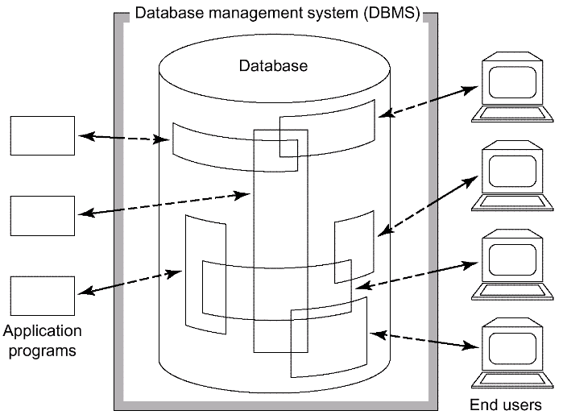
(1)
A database system is basically just a computerized record-keeping system.
Electronic filing cabinet
Fig. 1.4 Simplified picture of a database system

Slide 7
computerized record-keeping system
store information
allow users to retrieve and update that information on demand

Slide 8
(2)
A database system is a shared collection of logically related data (and a description of this data), designed to meet the information needs of an organization.
Data and information ?
Logical deals with how knowledge workers view their information needs, and includes such terms as:
  CHARACTER - our smallest unit of information.
  FIELD - group of related characters.
  RECORD - group of related fields.
  FILE - group of related records.
  DATABASE - group of logically associated files.
  DATA WAREHOUSE - information from many databases.

Slide 9
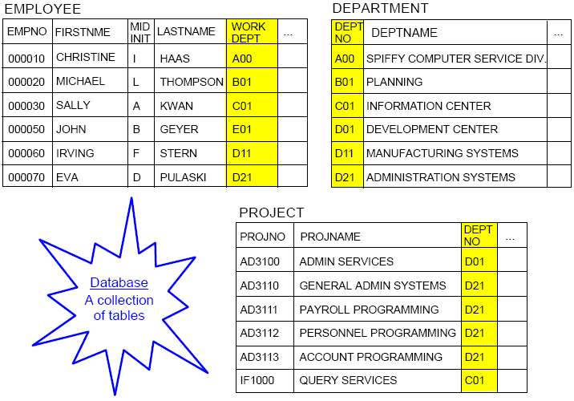

Slide 10
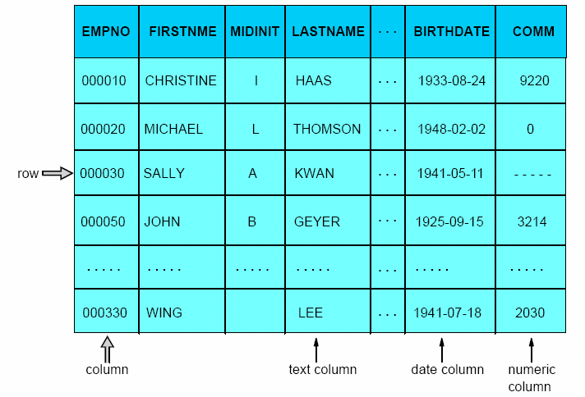
Relational Table: EMPLOYEE

Slide 11
File : table
Rows: records
Columns : fields
Column data types: domain
Primary key

Slide 12
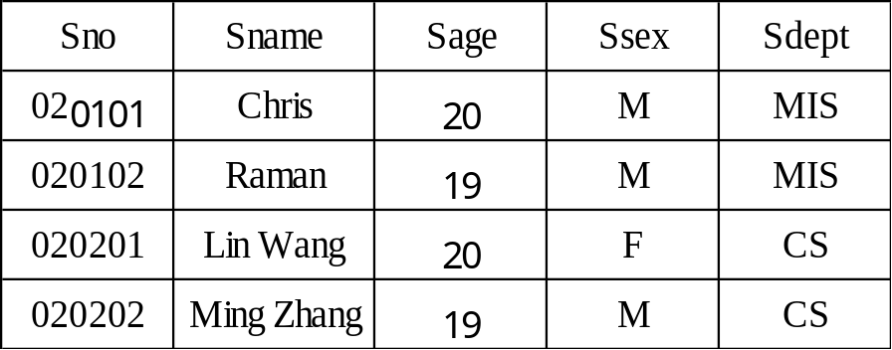
(3)
Student
  A database is a collection of persistent data that is used by the application systems of some given enterprise
  persistent data: be removed from the database only by some explicit request to the DBMS.
Enterprise examples:
  A manufacturing company
  A bank
  A hospital
  A university
  A government department
  A single individual with a small personal database
Data examples:
  Product data
  Customer data
  Patient data
  Student data
  Planning data
  Account data

Slide 13
(4)
A database system is really a collection of true propositions
Data is given facts, from which additional fact can be inferred.
A given fact is called true proposition by logician.

Slide 14
2 Why database?

Slide 15
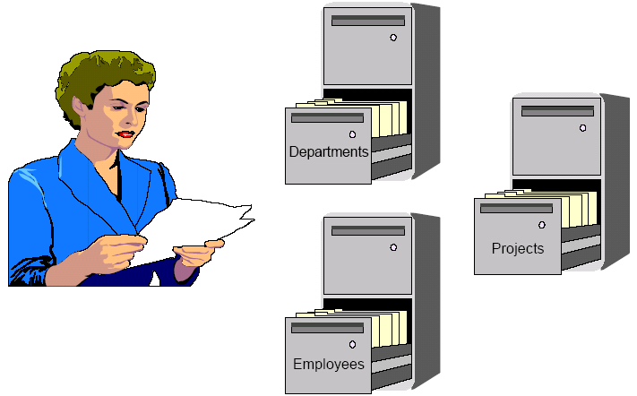
Computerless Data Storage

Slide 16
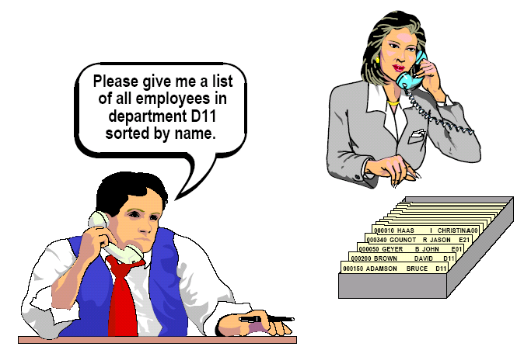
Computerless Data Retrieval

Slide 17
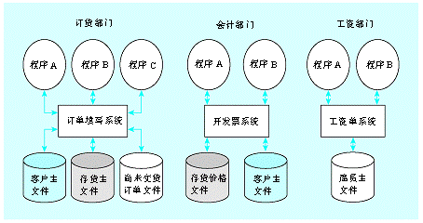
Traditional File-Based approach
A file-based system is a collection of application programs that performs services for the end-users such as the production of reports, but each program defines and manages its own data.

Slide 18
Limitations:
  Data are separated and isolated
  Data are often duplicated
  Application programs are dependent on file formats
  Need to write a new program to carry out each new task
  E.g. get the balance of accounts whose balance are less than 1000
  Files are often incompatible with one another
  It is difficult to represent data in the user's perspectives
  Integrity problems
  Integrity constraints (e.g. account balance > 0) become part of program code, Hard to add new constraints or change existing ones
  It is difficult to impose security on data
  Concurrent access by multiple users
  Concurrent access needed for performance
  Uncontrolled concurrent accesses can lead to inconsistencies
    E.g. two people reading a balance and updating it at the same time
  Database systems offer solutions to all the above problems

Slide 19
The Database Approach
The database approach: considering the data, instead of the application programs, of major importance in the design of systems -- i.e. look first at the design of the application’s data and then write programs to process it!
application
program
application
program
application
program
Maintenance and
utility programs
DATABASE
Schemas
Schemas define the structure of records within the database
Maintenance and utility offer application-independent services, e.g. report generator.

Slide 20
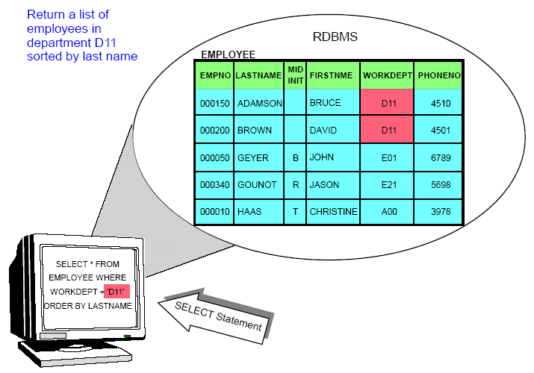
Asking for Information - RDBMS

Slide 21
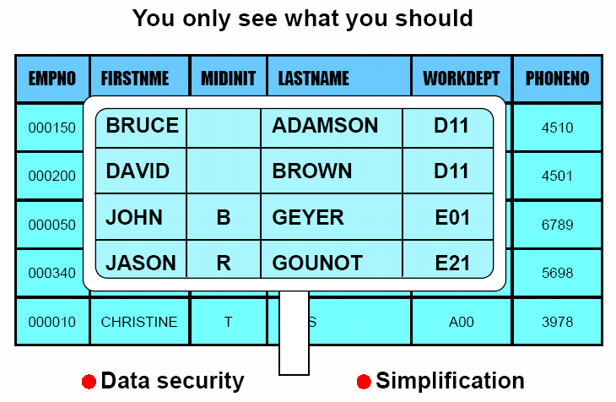
Benefits of the database approach
The data can be shared
Redundancy can be reduced
Inconsistent can be avoided propagating updates
Transaction support can be provided transaction is a logical unit of work
Integrity can be maitained (ensuring the data in database is correct)
redundancy→inconsistency +other incorrect
Security can be enforced
Conflicting requirements can be balanced
Standards can be enforced
standardizing data representation is desirable as an aid to data interchange or movement between systems
data naming and documentation standards ---data sharing and understandability

Slide 22
The advantages of a database system over file-based system
Compactness
Speed
Less drudgery
Currency
Provides the enterprise with centralized control of its data-----overriding advantage

Slide 23
3 Simple Operations on database (SQL)
File---
adding removing
Record---
Insert Delete Select Update
(SQL)

Slide 24
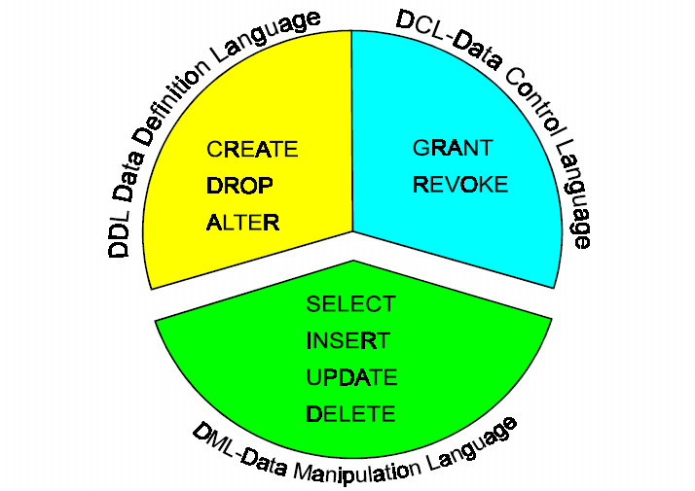
Structured Query Language--SQL
1986年10月，美国ANSI采用SQL作为关系数据库管理系统的标准语言(ANSI
X3. 135-1986)，后为国际标准化组织(ISO)采纳为国际标准。
SQL has become one of the most important elements of modern database technology. It is used very extensively by virtually all database systems and is a major vehicle in facilitating inter-database communication

Slide 25
DDL
DDL:Specification notation for defining the database
  E.g.
  create table account (
  account-number char(10),
  balance integer)

Slide 26
DML
Language for accessing and manipulating the data
  DML also known as query language
Two classes of languages
  Procedural – user specifies what data is required and how to get those data
  Nonprocedural – user specifies what data is required without specifying how to get those data
SQL is the most widely used non-procedural language

Slide 27
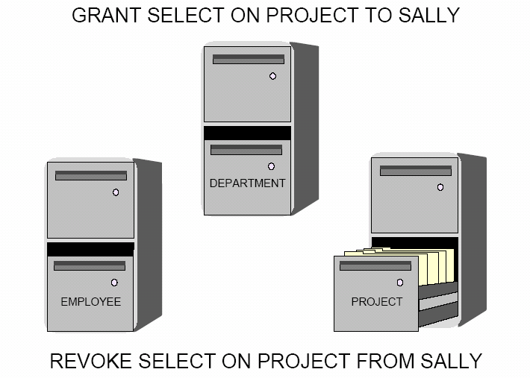
DCL

Slide 28
4 Components of the Database System
Data
Hardware Software
People
Machine
Bridge
Human

Slide 29
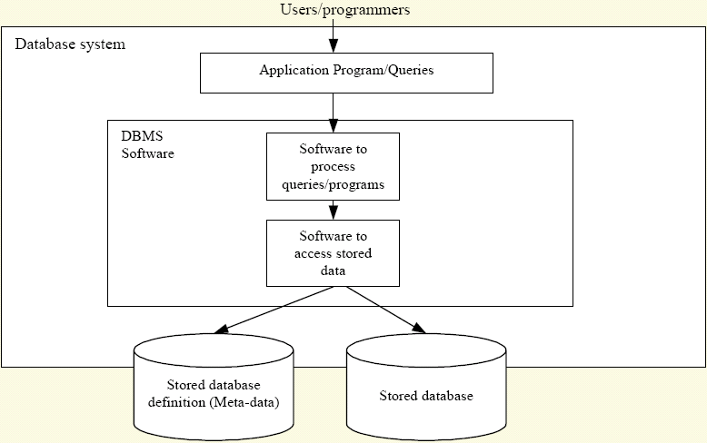
Database System

Slide 30

----Data
Data: refer to what is actually stored in the database
information refer to the meaning of that data as understood by some user.
  The terms “data” and “information” are treated as synonymous(同义的) in this book.
Fig. 1.5 The EMPLOYEE and ENROLLMENT files

Slide 31
Single-user system is a system in which at most one user can access the database at any given time.
Muti-user system is a system in which many users can access the database at the same time.
Two assumptions in our book: multi-user system, data store in a single DB
The data in database is
Integrated.
(database can be thought of as a unification of distinct files with redundancy eliminated)
shared ⬄ personal or application-specific
persistent ⬄ ephemeral

Slide 32
----Hardware
Consisting of :
  magnetic disks, disk drives: store information (the secondary storage)
  Hardware processor(s) and associated main memory: running DBS software

Slide 33
----Software
Database Management System (DBMS).---the most important software
component
Eg., Sybase、Oracle、SQL Server、Informix、FoxBase、FoxPro、Access…
database package is used to refer to a DBMS implementation offered by a particular vendor
Application development tools
Design aids
Report writer
Transaction manager or TP monitor

Slide 34
Database Management System (DBMS) is the software that manages and controls access to the database -- an integrated part of our day-to-day life that often we are not aware we are using one.
A DBMS contains 5 software components:
DBMS engine
Data definition subsystem
Data manipulation subsystem
Application generation subsystem
Data administration subsystem

Slide 35
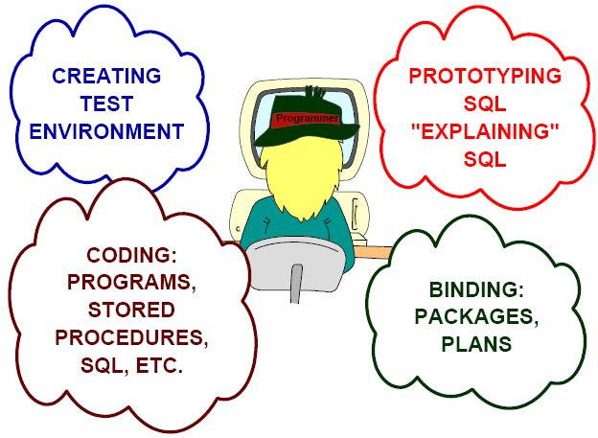
----Users
Application programmers
COBOL,PL/I,PB,JAVA…

Slide 36
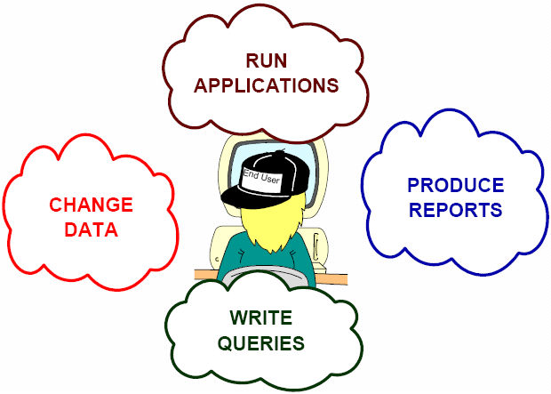
End user
interacting with system from online workstations or terminals.
access data by: online applications
inferface (Query language processor )
menu or forms-driven interfaces
command –driven interfaces

Slide 37
Database administrator(DBA)-- IT technician
1 responsible for implementing the data administrator's decisions.
2 create the actual database and to implement the technical controls needed to enforce the various policy decisions made by the data administrator.
DBA is responsible for administrating the DB and DB system in accordance with policies established by data administrator
Data Administrator (DA,数据管理员) --manager
1 decide what data should be stored in the database in the first place
2 establish policies for maintaining and dealing with that data once it has been stored.
Data administator –has central responsibility for data, understand the data and needs of enterprise

Slide 38
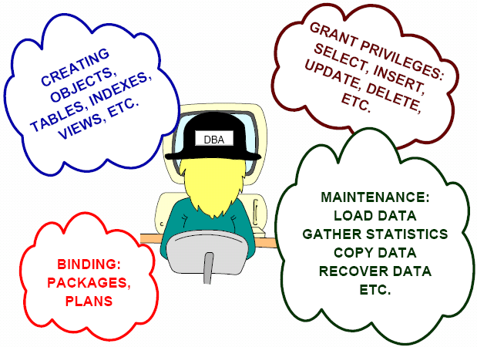
Database Administrator

Slide 39
5 Types of data models
and the differences between them

Slide 40
Data model
A data model is an abstract, self-contained, logical definition of the objects, operators and so forth. That together constitute the abstract machine with which users interact
the object allow us to model data structure
the operators allow us to model its behavior

Slide 41
database system are categorized according to data structures and operators they present to the user
Types of data models
1 Hierarchical Model
such as IBM’s IMS
traversing points
2 Network Model
CUSTOMER
ORDER 1
ORDER 2
Item 1.1
Item 1.2
Item 1.3
Hierarchical Model Database and Network Model Database
Limitations:
Complex programs have to be written to answer even simple queries
There is minimal data independence
There is no widely accepted theoretical foundation

Slide 42
3 Relational model
data is represented as rows in tables( it is a true proposition)
Operators are provided for operating on rows in tables
is based on logic and mathematics (Why so dominant?)
4 object/relational model such as DB2 and informix
5 object model entirely different such as Gemstone and Versant ODBMS
Others are ad hoc, relational model is based on formal logic

Slide 43
An implementation of a data model
---- is a physical realization on a real machine of the components of the abstract machine that together constitute that model
The model is what users have to know about
but the implementation is what users do not have to know about.
the distinguish of model and implementation is a special case of Logical and physical.
Gap between database principle（ought to be) and database practice( actually are)

Slide 44
6 Data Independence

Slide 45
Logical Data Independence
Physical Data Independence
  Change the data physical representation and access technique without affecting the application.
  Data physical representation:how the data is physically represented in storage
    Eg1. EMPLOYEE file:
    indexed on its "employee name" field
    Eg2. SALARY field of EMPLOYEE file:decimal or binary
  Data access technique: how the data is physically accessed

Slide 46
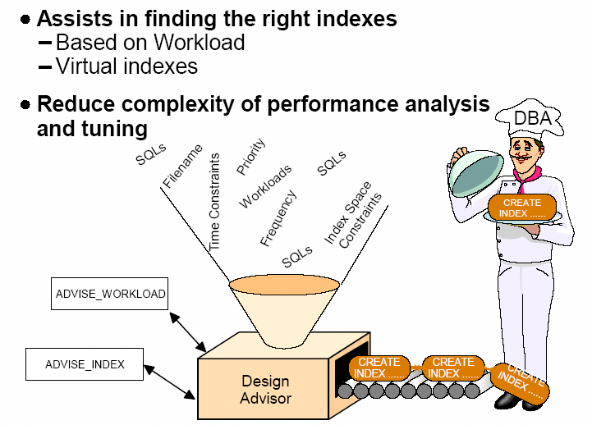
Index

Slide 47
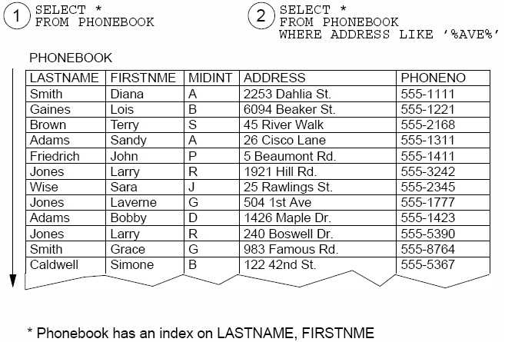
10. Database Administrator(Cont.)
Relation Scan

Slide 48
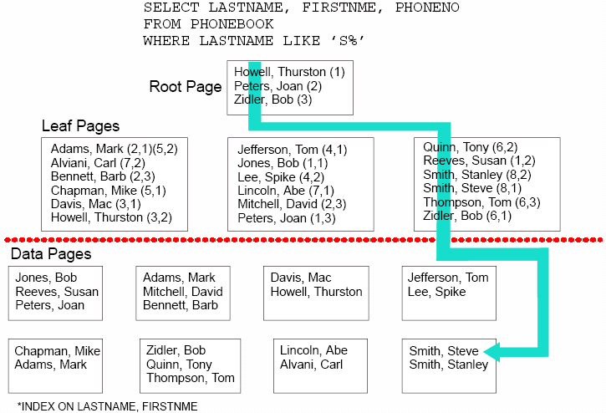
10. Database Administrator(Cont.)
Index-Only Access
Relation Scan

Slide 49
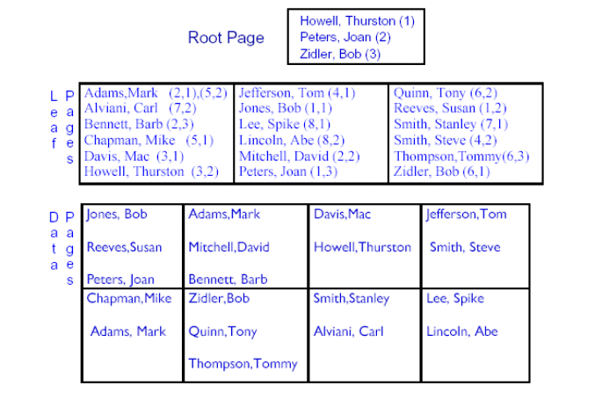
Non-Clustered index

Slide 50
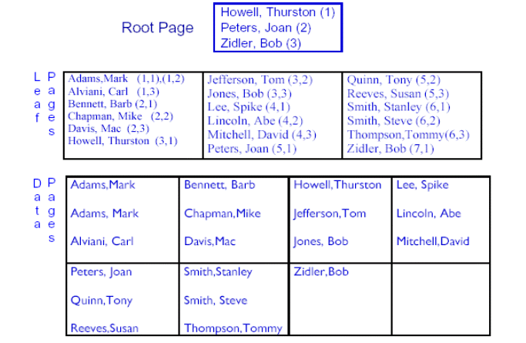
Clustered index

Slide 51
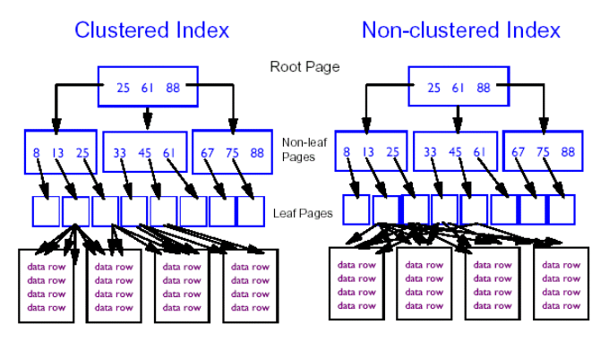
Clustered and Non-Clustered Index Access

Slide 52
Data-independence is a major objective for Database system
For the following two reasons:
Different applications will require different views of the same data
The DBA must have the freedom to change the physical representation or access technique in response to changing requirements without having to modify existing applications.
eg:new kinds of data,new standards,application priorities,new storage devices………year 2000
Data-independence can be defined as the immunity of applications to change in physical representation and access technique

Slide 53
Stored representation of data
Representation of numeric data:
  decimal, character string,… (base,scale,mode,precision)
Representation of character data:
  several distinct coded character sets—e.g., ASCII(American Standard Code for Information Interchange, EBCDIC(Extended Binary Coded Decimal Interchange Code) , Unicode（统一码、万国码、单一码、标准万国码）.
Units for numeric data:
  inches/centimeters
Data coding:
  (part color="Red" or "Blue" or "Green" ...)
  1 = "Red," 2 = "Blue," ...

Slide 54
Stored representation of data
Data materialization: constructing an occurrence of the logical field from the corresponding stored field occurrence and presenting it to the application
Direct:
single stored field instance
logical field
application
Indirect:
several stored field instance
computation
logical field
application

Slide 55
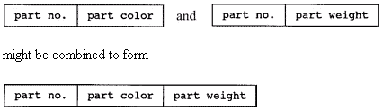
Stored representation of data
Structure of stored records:
  Two existing stored records might be combined into one.
  a single stored record type might be split into two.

Slide 56
Stored representation of data
Structure of stored files :
  A given stored file can be physically implemented in storage in a wide variety of ways.
  a single disk
  several different device
  one or more indexes ,one or more embedded pointer chains (or both)
  some hashing scheme
DBA choose the stored representation of data.
Won’t affect applications, but performance

Slide 57
Physical data independence
Physical data independence：DBA make changes the stored representation of data while the data as seen by applications does not change.
Basic way to provide data independence :
  three-level architecture

Slide 58
7 Others……

Slide 59
When not to use a database system?
DBMS requires additional overhead!
  High initial investment in hardware, software and training.
  Overhead for providing security, concurrency control, recovery and integrity functions.
There are still a lot of applications that use files.
  The database and application are simple, well-defined, and not expected to change -- usually dealing with small size of data (better either in a file or main memory!)
  There are stringent real-time requirements for some programs that may not be met because of DBMS overhead.
  Multiple-user access to data is not required.

Slide 60
The major events
in the database systems history
1961 The first generalized DBMS-GEs by Bachman
1970 The relational model is developed by Codd at IBM research Lab
1975 Entity-Relationship (ER) model introduced by Chen
Research projects: System R (IBM), INGRES (UCberkeley),System2000(UT-austin)
80’s and 90’s
  Micro-DBMS family: Dbase, Foxpro, Access
  Mainframe DBMS: DB2
  Client-server DBMSs: ORACLE, Sybase, SQL server…
The System R project at IBM (1970s) led to two major developments:
1, SQL,
2,Commercial relational DBMS products (1980s) such as DB2 and SQL/DS from IBM and ORACLE from ORACLE

Slide 61
Group(Semester) project- section 1
Survey and describe database requirements of an organization (company, enterprise or department), briefly introduce its background,
  If they have information systems?
  If YES, how to use information systems? What roles that database are playing?
  If NO, is there any plan to implement a database system, in which what functions that database will have ?
  Describe main business processes of the surveyed object.

